Slide 1
‘UK Fiscal Risks and Sustainability Report 2023’
Overview

Slide 2
Background
High Risk Exposure: The UK remains one of the most gas dependent economies in Europe, and now relies primarily on gas imports.
High Transition Costs: The country faces significant residual costs to replace gas-fired power stations and gas-fuelled heating systems.
Strong Market Incentives: Current high gas prices present a fiscal opportunity to move to cheaper renewable energy sources.

Slide 3
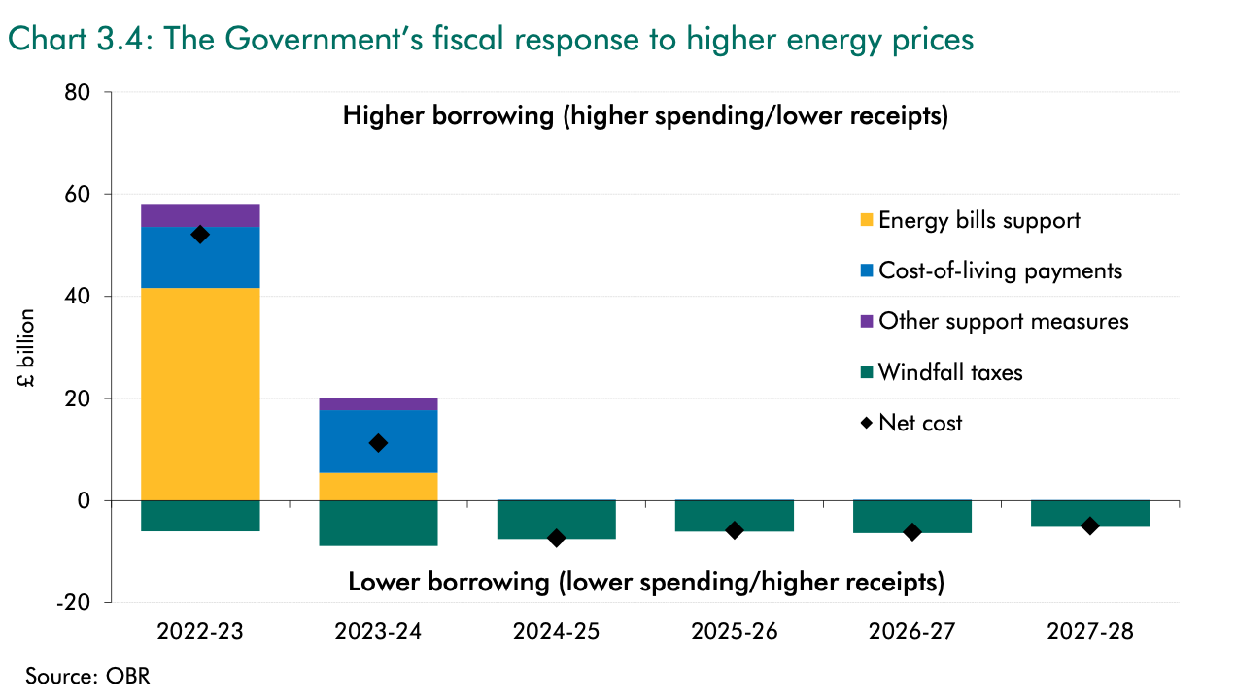
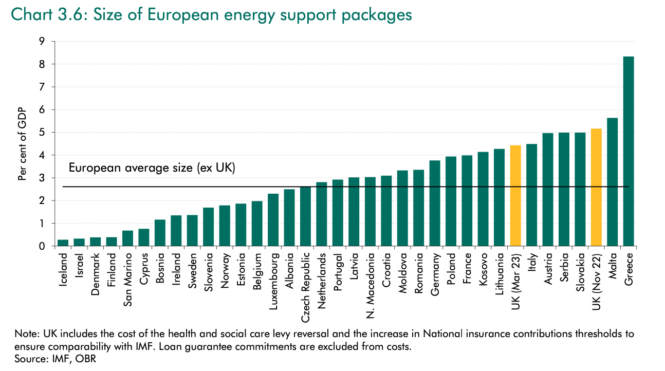
Energy Prices
Gas prices surged to 13 times their pre-crisis levels post-Russian invasion of Ukraine, subsequently moderating but anticipated to remain double their pre-pandemic levels through to 2025.
Impact: Energy price shock hit real household disposable incomes hardest.
Mitigation: 2.3% of GDP spent on energy support schemes and use of pandemic-era savings.
  UK fiscal support ~150% of European average over the past two years.

Slide 4
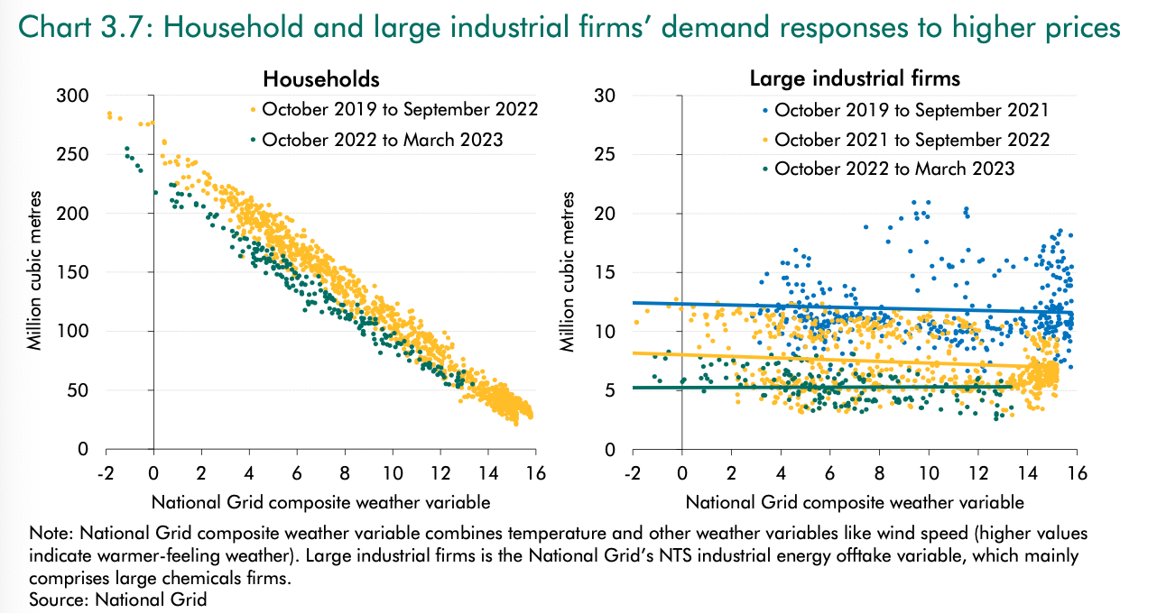
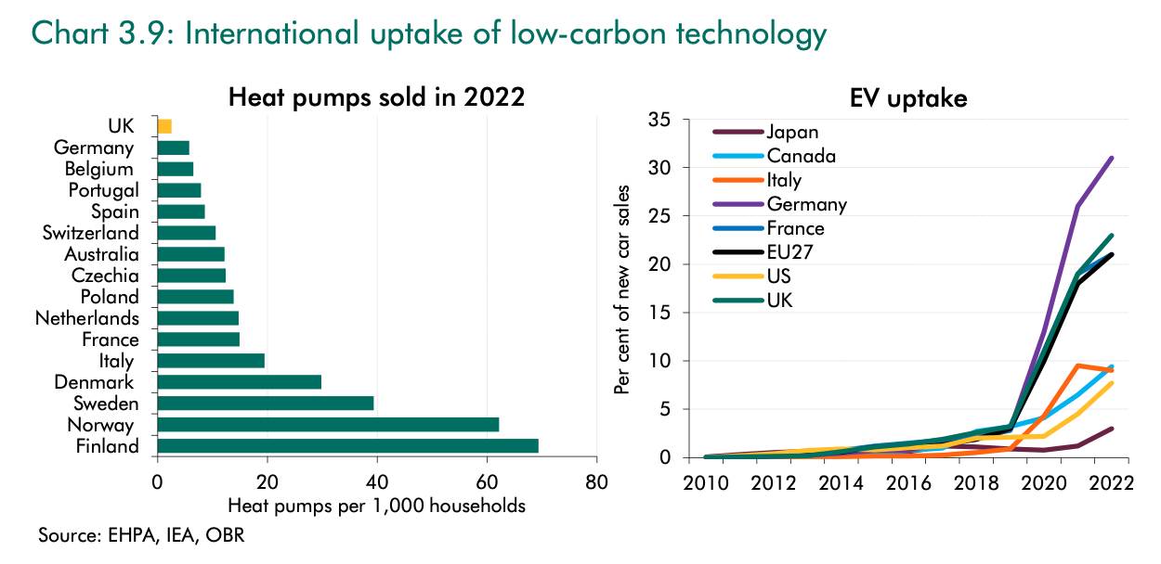
Demand Response
2022 Gas Consumption: Domestic down 10%, largest drop in a decade; industrial also fell gradually.
Comparative Demand: UK's gas demand fell less than European average.
Heat Pumps: Only 2.5 per 1,000 households bought, lowest among major European countries.

Slide 5
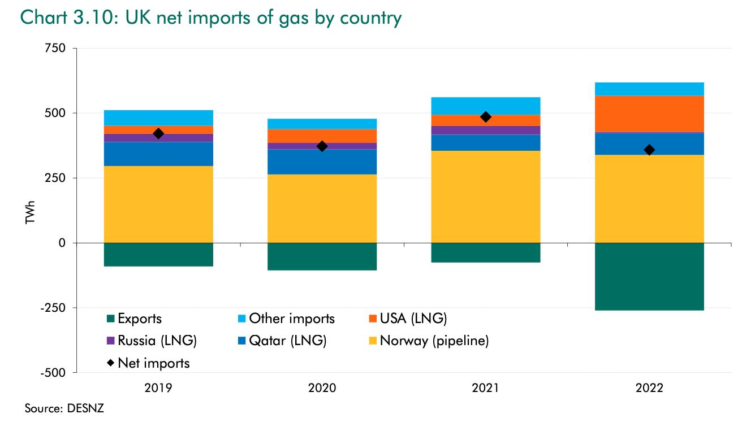
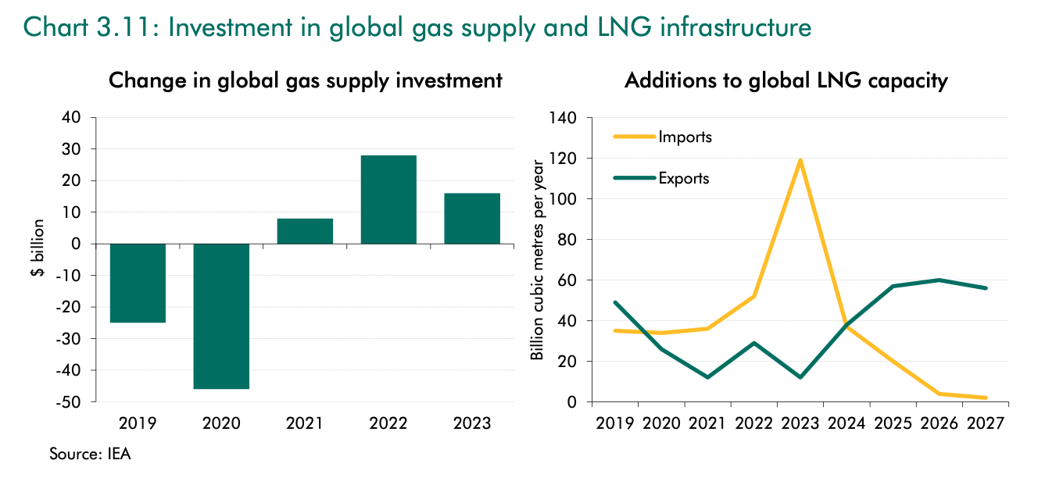
Supply Response
Gas Production: Strong response to rising European prices; Russian production fell sharply; global output expected to remain flat.
UK Exports: More than doubled, processing and exporting LNG to Europe.
Investment: Significant expansion of global LNG** import/export capacity.
**LNG is likely to be a more expensive and equally, if not more, price volatile source of energy than pipeline gas.

Slide 6
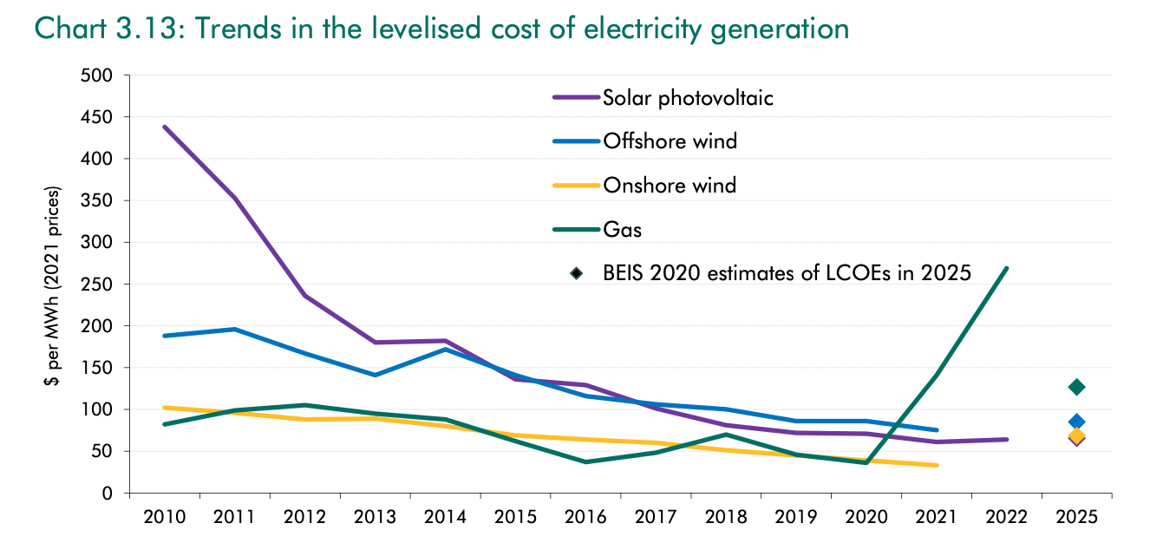
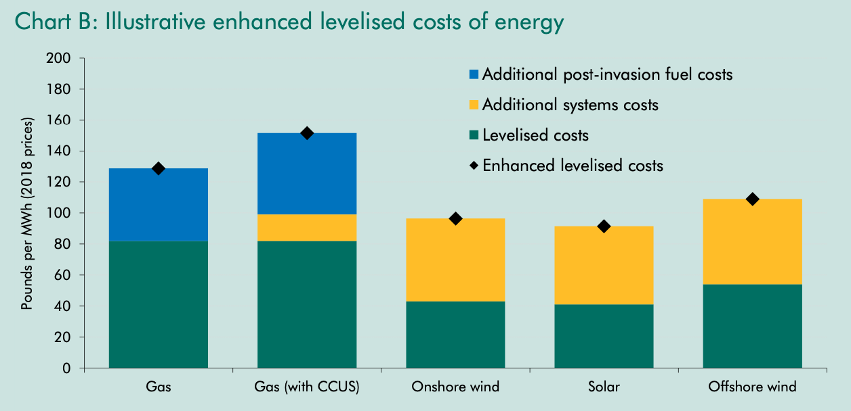
Alternative Supply Response
Gas Cost: Now the most expensive fuel per megawatt hour in the UK.
Renewables Growth: Modest increases in 2022:
  11% rise in wind generation capacity.
  4% increase in UK solar capacity.
  Rest of Europe experienced a stronger 22% expansion in solar power.

Slide 7
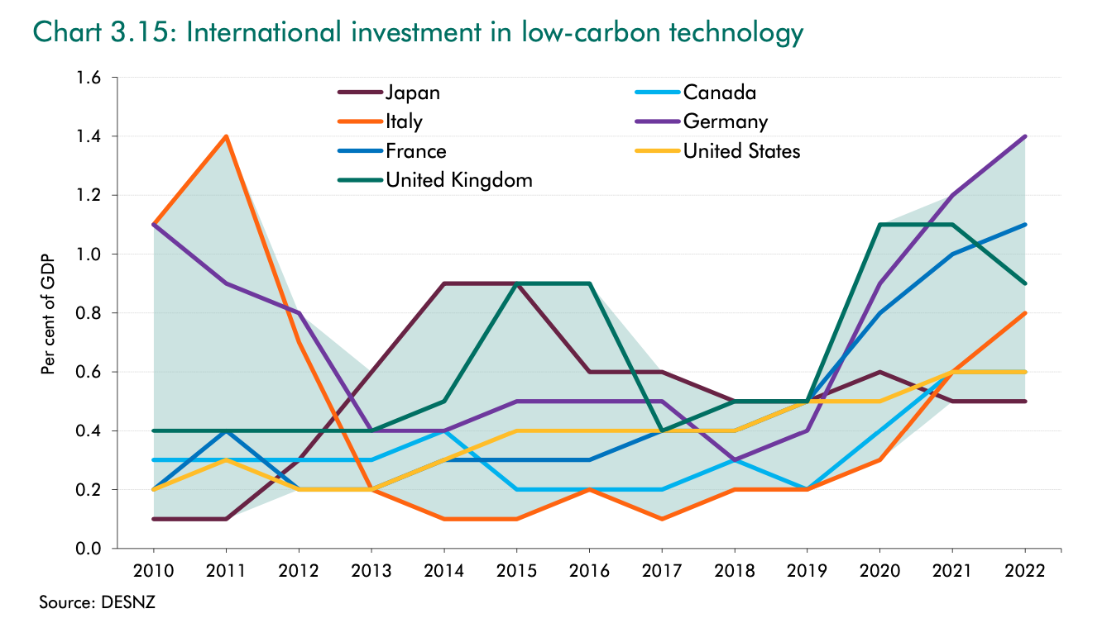
Transition Opportunity
Renewables: Less volatile with zero fuel costs and predictable construction costs.
Influencing Factors: Planning system, government, and regulators affect power system response.
Investment Impediments: Long, uncertain permitting system and grid connection wait times in the UK.

Slide 8
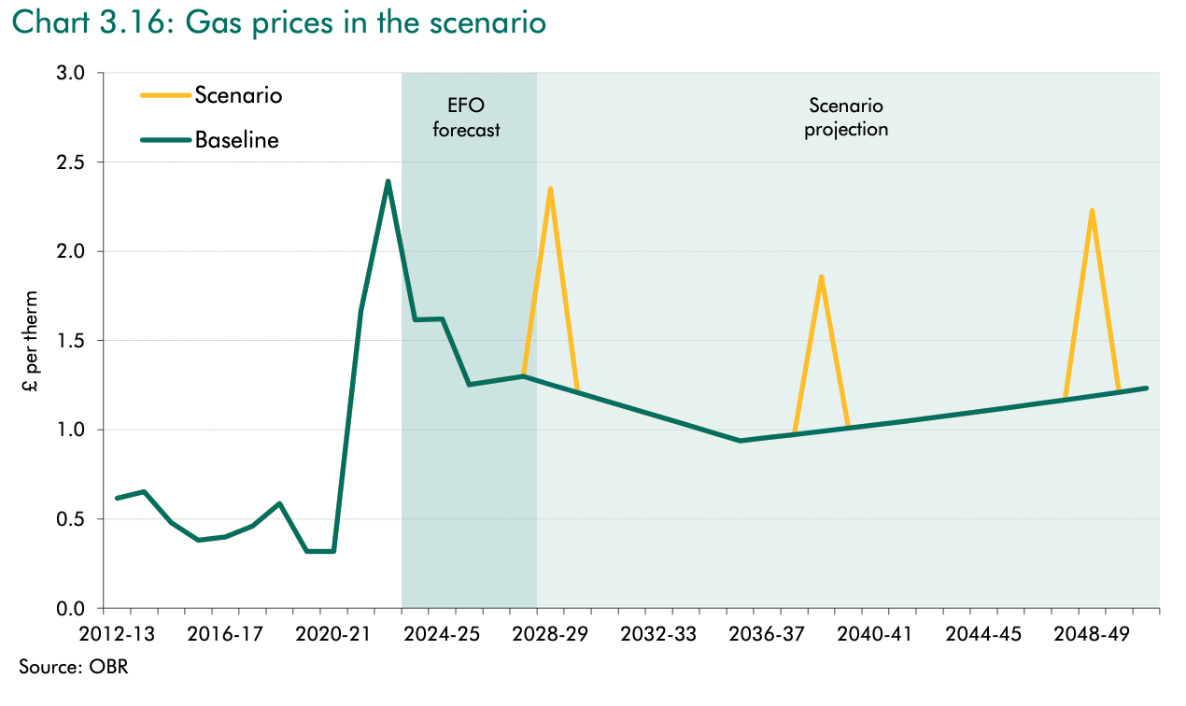
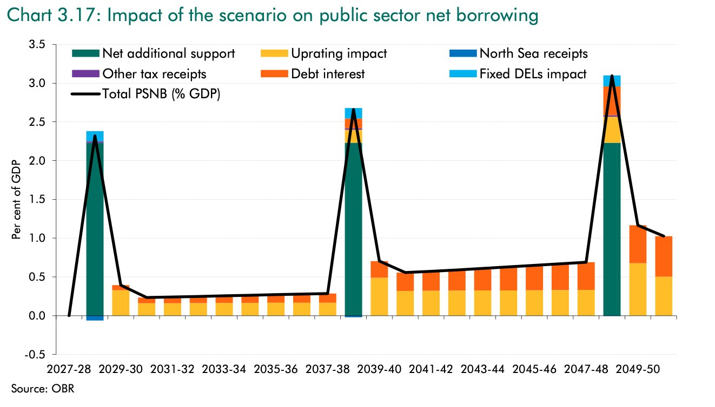
Continued Gas Reliance Scenario
Increased Exposure: UK 200% more exposed during price spikes by late 2030s.
Fiscal Impact:
  Wider primary deficit and higher debt.
  Future gas price volatility costs (13% of GDP) less than achieving net zero (21%), but more than direct public investment (6%) and gas-related costs (3%).

Slide 9
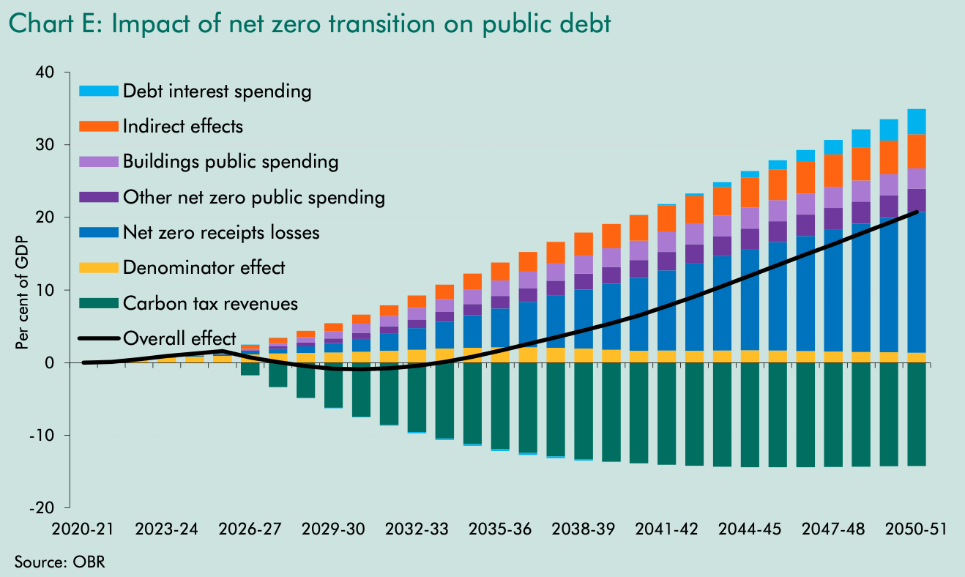
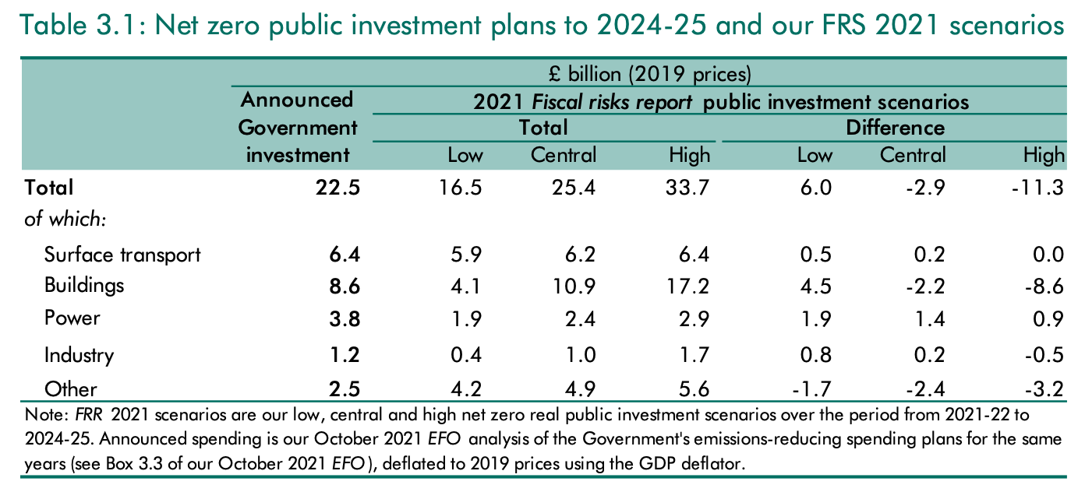
Updated Fiscal Cost
Private Sector Projection: The 2021 Report predicted most costs would be borne by the private sector.
Current Assessment: Limited response from private energy investors to renewable energy price changes heightens risks to public finances.
The 2021 Report remains the sole published estimate of fiscal costs for achieving net zero in the UK.
  Recent strategies lack a clear breakdown of intended public-private investment split.

Slide 10
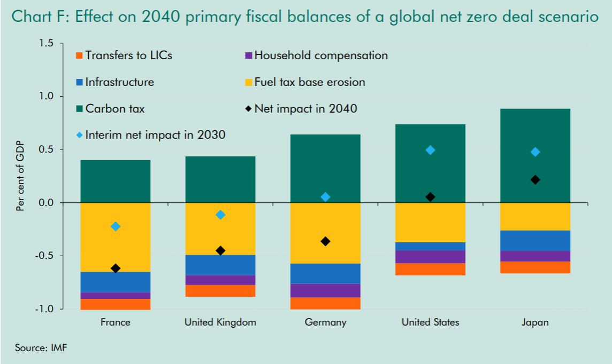
IMF Updated Fiscal Cost
Cross-country comparisons: IMF analyzes primary borrowing impacts under a 'global deal scenario' for net zero.
UK, Germany, France: Carbon tax likely insufficient to cover fuel tax erosion and public investment costs for net zero.
Assumptions:
  Less public spending for building sector decarbonization.
  Compensation for bottom three income deciles.
  Modest transfers to low-income countries.

Slide 11
Discussion
Does this form the basis for a framework for fiscal risks from energy?
How does the short term response to fiscal shocks from energy prices vary by country?
What are the standardized charts and scenarios in such a report?
What about the long term fiscal costs/benefits of climate mitigation: are these adequately represented?

